Slide 1
SESSION 2
Goal: match a framed disciplinary problem to the right class of classical ML methods.
Classic Machine Learning Overview
Regression • Classification • Clustering • Dimensionality Reduction • Forecasting • Anomaly Detection
Session focus
• ML workflow
• Supervised vs. unsupervised
• Six core task families
• Scenario sorting activity
• Discussion on model fit
Applied AI Design Workshop for Faculty
Fred Livingston (fjliving@ncsu.edu) 2026
1

Slide 2
APPLIED AI DESIGN WORKSHOP
Session 2
Workshop outcomes and Session 2 role
Session 2 gives faculty the “model-family map” needed after Session 1 problem framing and before regression/classification fundamentals.
Translate
Disciplinary question → ML task
Differentiate
Regression, classification, clustering, forecasting
Baseline
Know what a simple model must beat
Evaluate
Link task type to first metrics
Select
Choose method families before tools
Design principle: the question determines the learning task; the learning task constrains the models and metrics.
2

Slide 3
APPLIED AI DESIGN WORKSHOP
Session 2
Day 3 schedule and flow
From engineering problem to ML problem
Done
Classic ML overview
Now
Invited presentation: From Prompts to Agents
Context
Break
Regression fundamentals
Methods
Classification fundamentals
Hands-on baseline model activity
Practice
3

Slide 4
APPLIED AI DESIGN WORKSHOP
Session 2
Learning activities for Session 2
1. Map
2. Sort
3. Compare
4. Select
5. Discuss
Connect problem statement to task type
Classify six scenarios
Supervised vs. unsupervised use cases
Choose first metrics and baselines
Identify mismatches and ambiguous cases
Participant output: a task-family recommendation for each scenario plus one “why this task, not another?” explanation.
4

Slide 5
APPLIED AI DESIGN WORKSHOP
Session 2
Classic ML workflow: from problem to evidence
Problem
decision or prediction
Data
inputs, target, unit
Features
clean, encode, derive
Model
train task-specific method
Evaluate
baseline + metrics
Interpret
error, limits, usefulness
Classic ML emphasizes structured data, explicit targets or patterns, measurable performance, and reproducible comparison to baselines.
Key question for today: where does your problem sit in this workflow?
5

Slide 6
APPLIED AI DESIGN WORKSHOP
Session 2
Supervised and unsupervised learning
Supervised learning
Uses examples with known targets.
Typical tasks:
• Regression
• Classification
• Forecasting
Core question:
Can the model learn from labeled examples to predict a new case?
Unsupervised learning
Uses data without known targets.
Typical tasks:
• Clustering
• Dimensionality reduction
• Pattern discovery
Core question:
Can the model reveal structure that merits domain interpretation?
Boundary case: anomaly detection can be supervised, semi-supervised, or unsupervised depending on whether labeled abnormal cases exist.
6

Slide 7
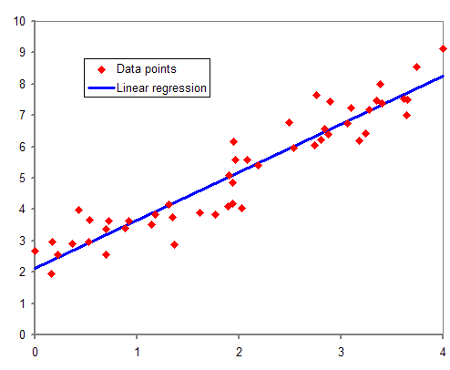
APPLIED AI DESIGN WORKSHOP
Session 2
Regression: predicting continuous outcomes
Use regression when the target is a number and error magnitude matters.
Questions
• How much?
• How many?
• What value?
Outputs
• Continuous prediction
• Prediction error
Common methods
• Linear regression
• Polynomial regression
• Ridge / Lasso
• Regression trees
• Random forests
First metrics
• MAE
• RMSE
• R²
Baseline
• Predict mean/median
Source: https://en.wikipedia.org/wiki/Regression_analysis#/media/File:Normdist_regression.png
Examples: final material strength, energy consumption, cycle time, bioprocess yield, exam score, remaining useful life.
7

Slide 8
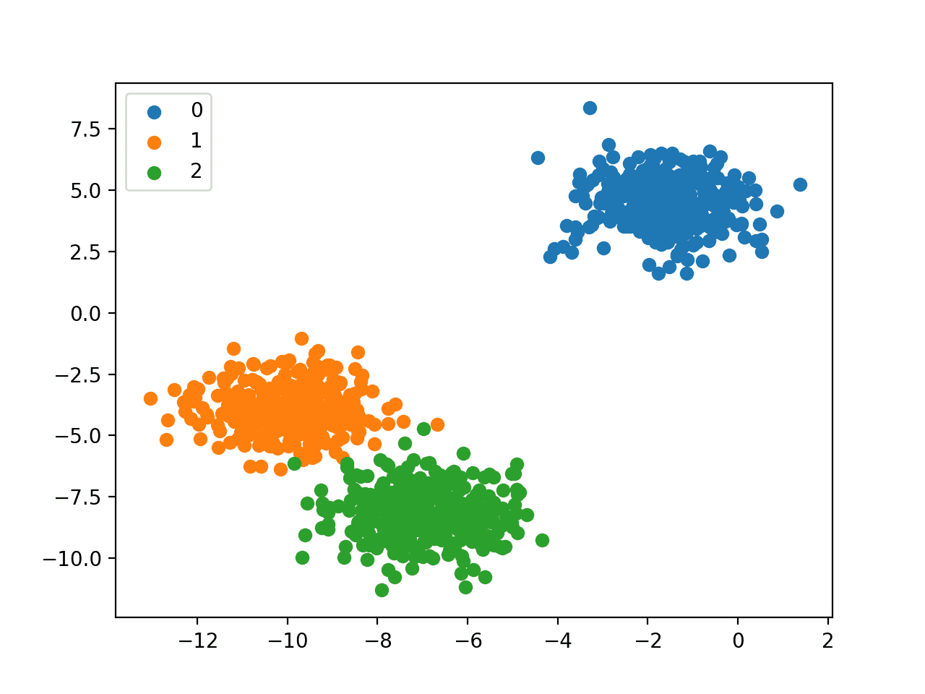
APPLIED AI DESIGN WORKSHOP
Session 2
Classification: predicting categories
Use classification when the output is a discrete category, label, or decision class.
Questions
• Which class?
• Pass or fail?
• Fault or normal?
Outputs
• Class label
• Probability
Common methods
• Logistic regression
• Decision trees
• k-nearest neighbors
• Support vector machines
• Random forests
First metrics
• Accuracy
• Precision
• Recall
• F1-score
Baseline
• Majority class
Source: https://machinelearningmastery.com/types-of-classification-in-machine-learning/
Examples: product accept/defect, medical screening, equipment fault state, material type, student support category.
8

Slide 9
APPLIED AI DESIGN WORKSHOP
Session 2
Clustering: finding groups without labels
Use clustering when the goal is to explore unlabeled data and identify possible groups.
Questions
• What groups exist?
• Are there operating regimes?
• Are there natural profiles?
Outputs
• Cluster ID
• Similarity grouping
Common methods
• k-means
• Hierarchical clustering
• DBSCAN
Preconditions
• Meaningful features
• Appropriate scaling
Evaluation
• Cluster separation
• Stability
• Domain interpretation
Caution
• Clusters are not automatically scientific categories
Examples: operating regimes, product families, student learning profiles, patient subgroups, sensor behavior patterns.
9

Slide 10
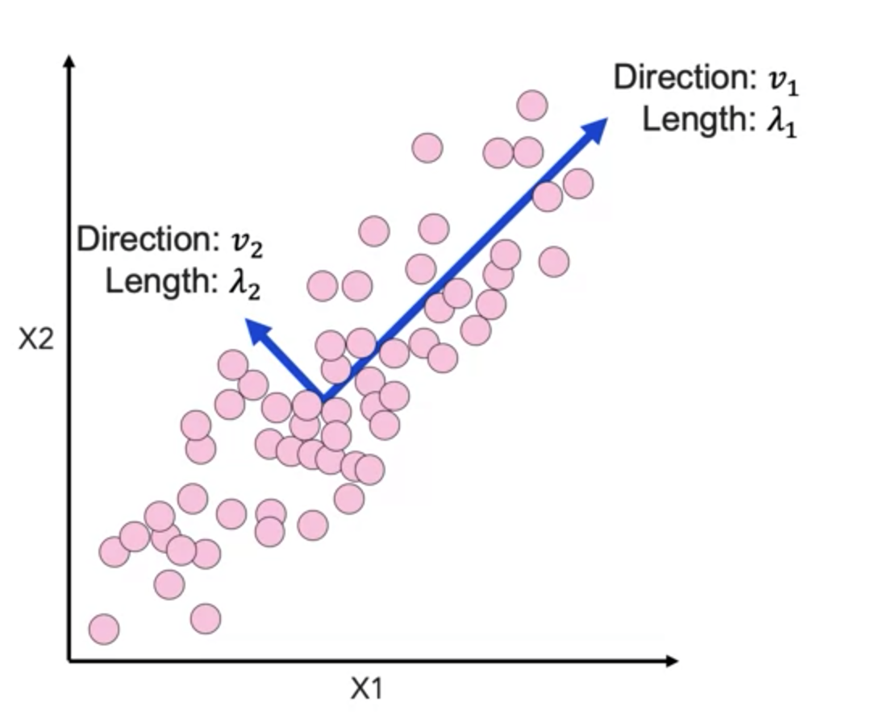
APPLIED AI DESIGN WORKSHOP
Session 2
Dimensionality reduction: simplifying many variables
Use dimensionality reduction when many correlated variables need to be summarized or visualized.
Questions
• Can many variables be summarized?
• What structure is visible in 2D?
• Which directions explain variation?
Common methods
• Principal component analysis
• t-SNE / UMAP for visualization
Outputs
• Components
• Low-dimensional projections
Use carefully
• Components may be hard to interpret
• Scaling matters
• Visualization is not proof of separability
Source: https://medium.com/the-quant-journey/unsupervised-machine-learning-dimensionality-reduction-and-pca-8ed5db205200
Examples: compress sensor streams, visualize high-dimensional experiments, reduce multicollinearity, explore image-derived features.
10

Slide 11
APPLIED AI DESIGN WORKSHOP
Session 2
Forecasting: predicting future values
Use forecasting when time order matters and future values depend on past behavior.
Questions
• What happens next?
• What will demand be tomorrow?
• How will a process variable evolve?
Common features
• Lags
• Rolling means
• Trends
• Seasonal indicators
• Time-window statistics
Validation
• Preserve time order
• Train on past, test on future
• Avoid random split leakage
Examples: energy demand, production throughput, sensor trends, inventory needs, process yield over time.
11

Slide 12
APPLIED AI DESIGN WORKSHOP
Session 2
Anomaly detection: identifying unusual observations
Use anomaly detection when rare, unexpected, or abnormal behavior is the focus.
Questions
• Is this unusual?
• Does this run deviate from normal?
• Which cases need review?
Common methods
• Thresholds
• Isolation forest
• One-class methods
• Distance-based methods
• Control-chart-inspired rules
Practical issues
• Rare labels
• False alarms
• Changing normal behavior
• Need for human review
Examples: equipment condition monitoring, lab-sensor drift, cybersecurity events, defective runs, unusual student activity patterns.
12

Slide 13
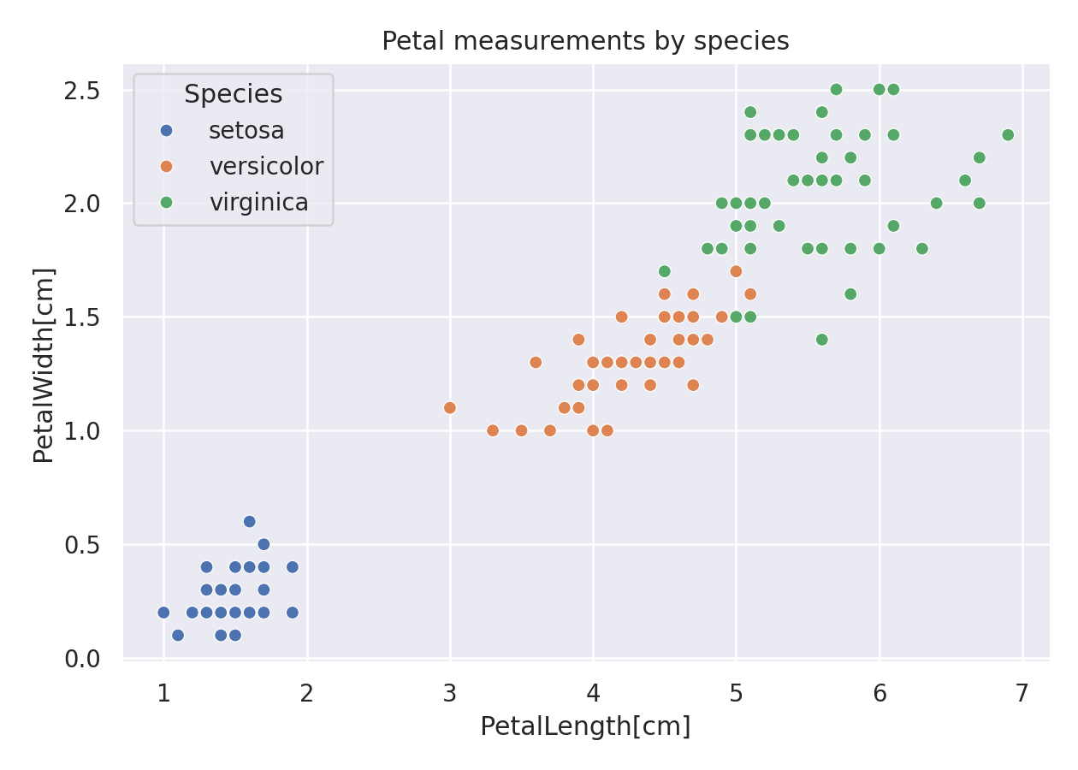
APPLIED AI DESIGN WORKSHOP
Session 2
Session 2 technical skill: visualize before modeling
Goal: use quick plots to understand relationships, distributions, and target balance.
import seaborn as sns
import matplotlib.pyplot as plt
sns.scatterplot(data=df,
x="PetalLength_cm",
y="PetalWidth_cm",
hue="Species")
plt.show()
Do classes appear separable?
Are there obvious outliers?
Is the relationship linear or nonlinear?
What should not be concluded from the plot?
Session 2 notebook
02_session2_visualization.ipynb
15

Slide 14
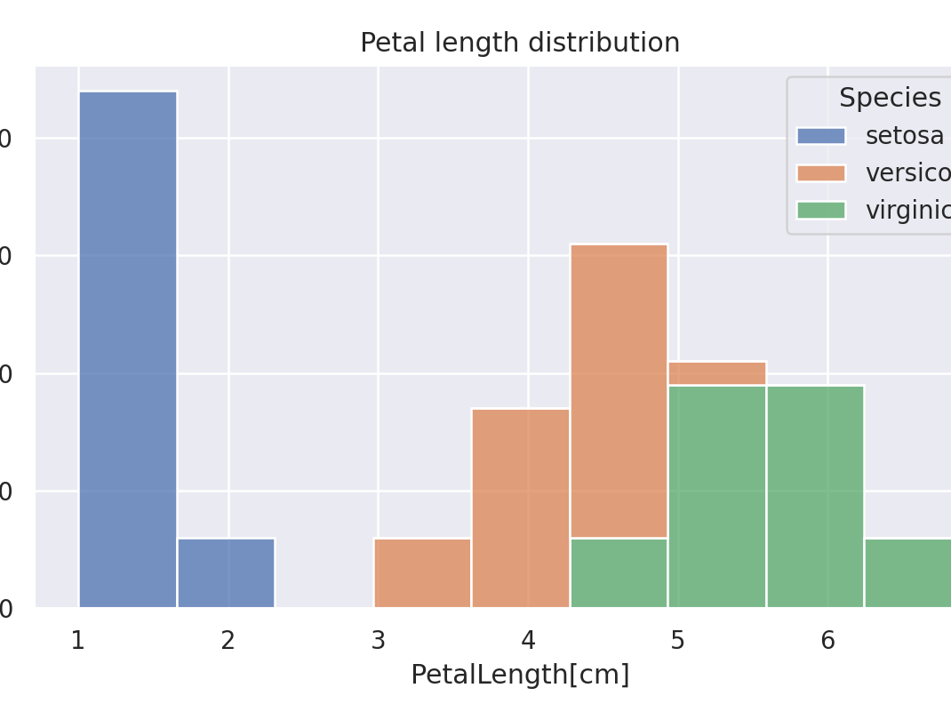
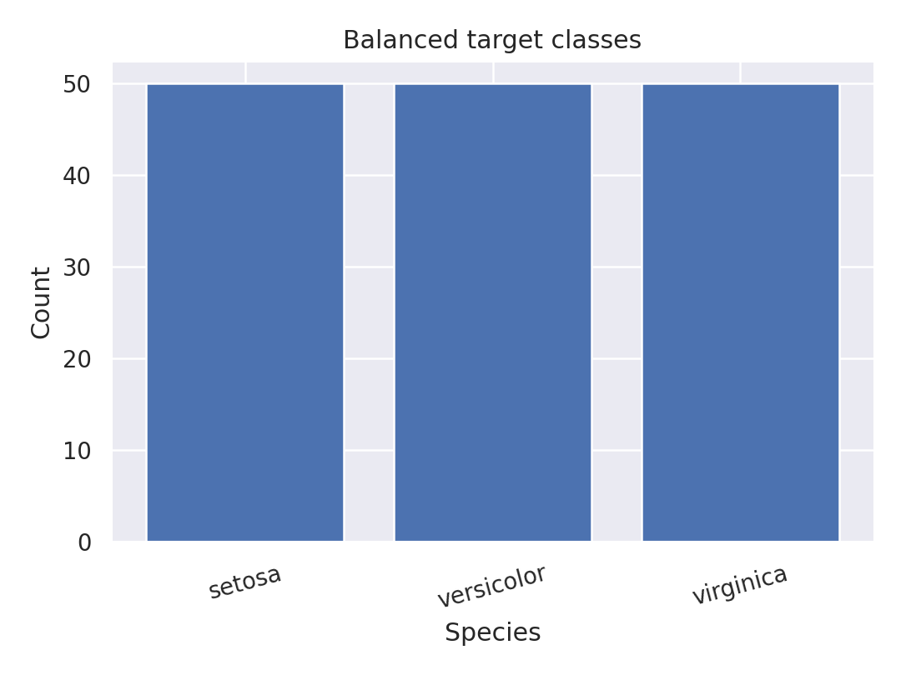
APPLIED AI DESIGN WORKSHOP
Session 2
Three reuse throughout the workshop
Use only the plots that support the applied modeling decision.
Scatterplot
relationship + separability
Histogram
distribution + overlap
Count plot
target balance
Instructor prompt
“Use the plot to decide what question to ask next. Do not treat visualization as proof of causality or final model performance.”
15

Slide 15
APPLIED AI DESIGN WORKSHOP
Session 2
Task chooser: match the question to the task
Task
Question
Data signal
Early metric or check
Regression
How much?
Continuous target
MAE / RMSE / R²
Classification
Which category?
Known labels
Precision / recall / F1
Clustering
What groups?
No target label
Separation + interpretation
Dimensionality reduction
Can we simplify?
Many variables
Explained variance
Forecasting
What next?
Time-ordered data
Future prediction error
Anomaly detection
What is unusual?
Rare or unknown events
False alarms / missed events
13

Slide 16
APPLIED AI DESIGN WORKSHOP
Session 2
Activity: scenario sorting
For each scenario, identify the ML task and defend the choice in one sentence.
A. Predict final strength from process parameters.
B. Determine whether an image shows abnormality.
C. Identify natural groups of participants.
D. Summarize 50 sensor variables into fewer components.
E. Predict next week’s energy demand.
F. Flag unusual laboratory measurements.
Debrief: Which scenarios were ambiguous? What extra information would resolve the task choice?
14

Slide 17
APPLIED AI DESIGN WORKSHOP
Session 2
Classroom discussion prompts
Can the same dataset support more than one task?
What task requires labeled data?
When is clustering scientifically meaningful?
How is forecasting different from ordinary regression?
How is anomaly detection different from fault classification?
What does classic ML provide that an LLM alone does not?
Discussion goal: make model choice a transparent disciplinary argument, not a default software selection.
15

Slide 18
APPLIED AI DESIGN WORKSHOP
Session 2
Session 2 outputs and transition
You should leave with:
1
A task-family choice for their framed problem
2
A reason the choice matches the research or teaching question
3
A first baseline idea
4
One evaluation metric or qualitative check
5
One ambiguity or missing data item to resolve
Next: Regression fundamentals — predicting continuous disciplinary outcomes and interpreting error.
16

